Slide 1
Object-Oriented Programming and Data Abstraction Lesson 3: Supporting Technologies a. Javadoc
Notes:
Replace this with your course title and your name/contact details.

Slide 2
Javadoc specifications for a method
Format of a Doc Comment
A doc comment is written in HTML and must precede a class, field, constructor or method declaration. It is made up of two parts -- a description followed by block tags. In this example, the block tags are @param, @return, and @see.
/**
* Returns an Image object that can then be painted on the screen.
* The url argument must specify an absolute {@link URL}. The name
* argument is a specifier that is relative to the url argument.
* <p>
* This method always returns immediately, whether or not the
* image exists.
*
* @param url an absolute URL giving the base location of the image
* @param name the location of the image, relative to the url argument
* @return the image at the specified URL
* @see Image
*/
public Image getImage(URL url, String name) {

Slide 3
Javadoc content
First Sentence
The first sentence of each doc comment should be a summary sentence, containing a concise but complete description of the API item. This means the first sentence of each member, class, interface or package description.
The Javadoc tool copies this first sentence to the appropriate member, class/interface or package summary.
The first sentence ends with the first period.
Tags to include (and their order)
@author (classes and interfaces only, required)
@version (classes and interfaces only, required)
@param (methods and constructors only)
@return (methods only)
@throws (methods only. The exceptions the method can throw, in order, with explanations of what would trigger them.)
@see
@since
@deprecated

Slide 4
Commenting Code
You must Javadoc all classes, interfaces and methods
Javadoc comments can be built into HTML documentation.
See examples from class website
To create the documentation:
Run the javadoc program with the source file as an argument
Ex: javadoc Comment3.java
The javadoc program will create index.html and several other documentation files in the same directory as the input file.
Or generate for a project in Eclipse

Slide 5
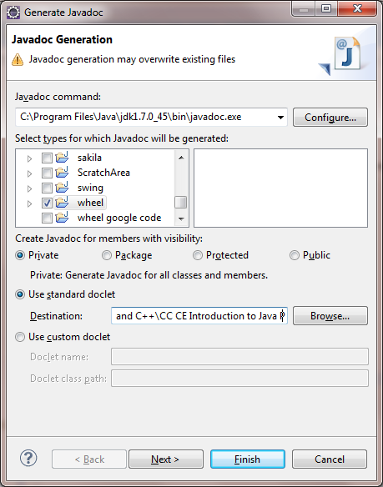
Eclipse Javadoc Generation
Javadoc can be generated from the Project menu
All labs and projects must be submitted with Javadoc, and the corresponding HTML files.
See http://jackmyers.info/oopda/maze_javadoc/

Slide 6
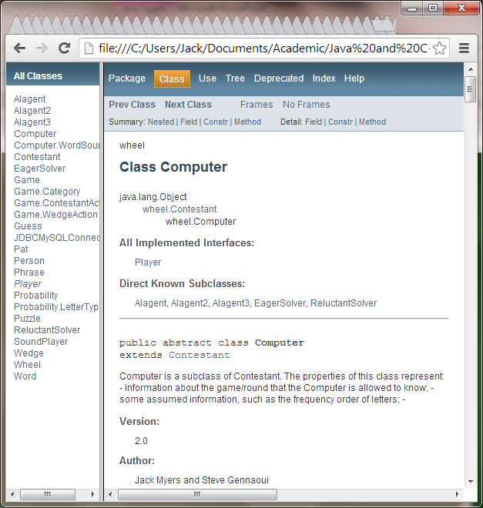
Example
class inheritance
For group assignments, you should indicate which team members coded which classes / methods
subclasses
version and author info

